Slide 1
WebGL Without Frameworks
An introduction

Slide 2
The History of the GPU

Slide 3
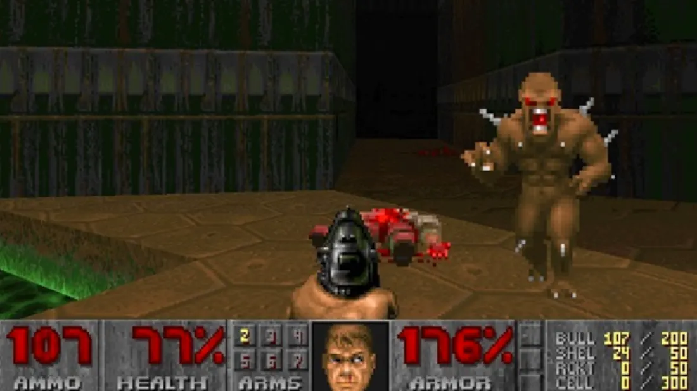
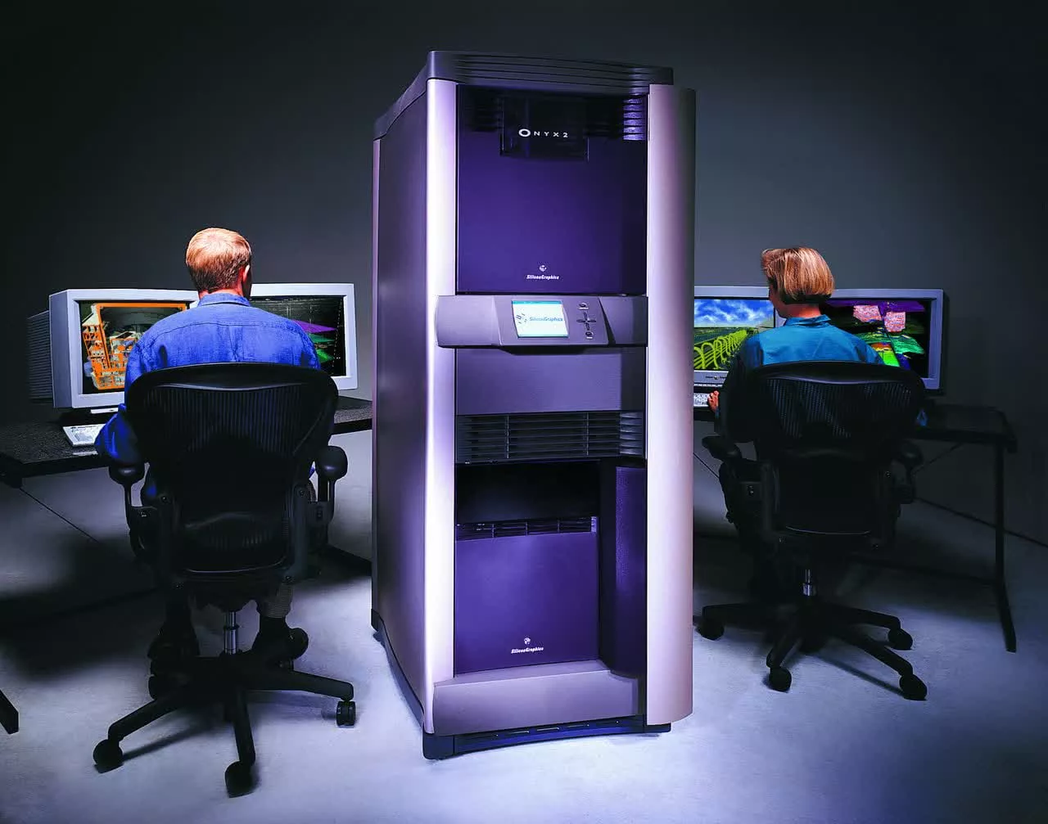
The Software Rendering Era
Early to mid 1990s
3D rendering hardware is prohibitively expensive
Only practical option for fast 3D was software rendering
Limitations
640x480 resolution == 307,200 pixels per frame
CPU can only draw 1 at a time
60fps x 307,200 == 18 million pixels per second
Gets worse as resolution increases
Hogs CPU time needed for other tasks
Rendering limited by CPU speed

Slide 4
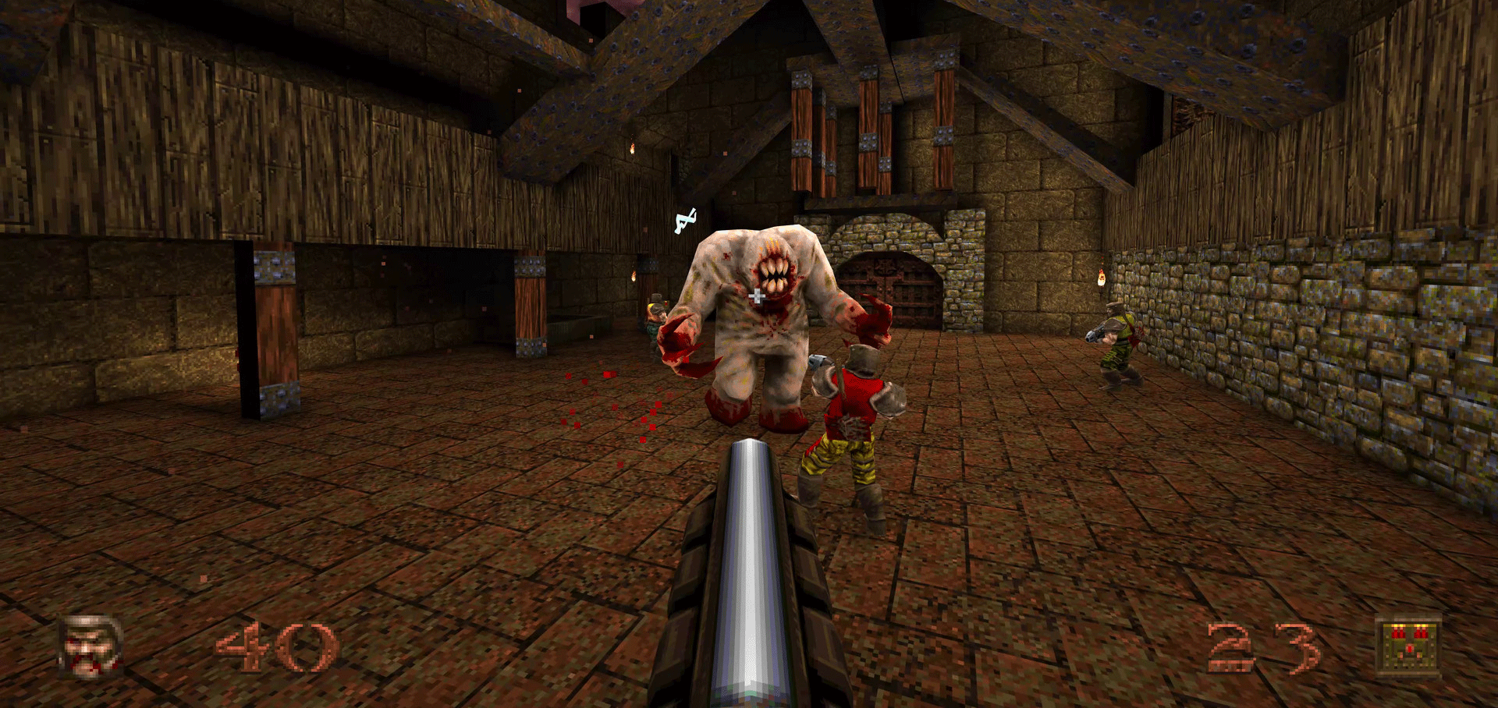
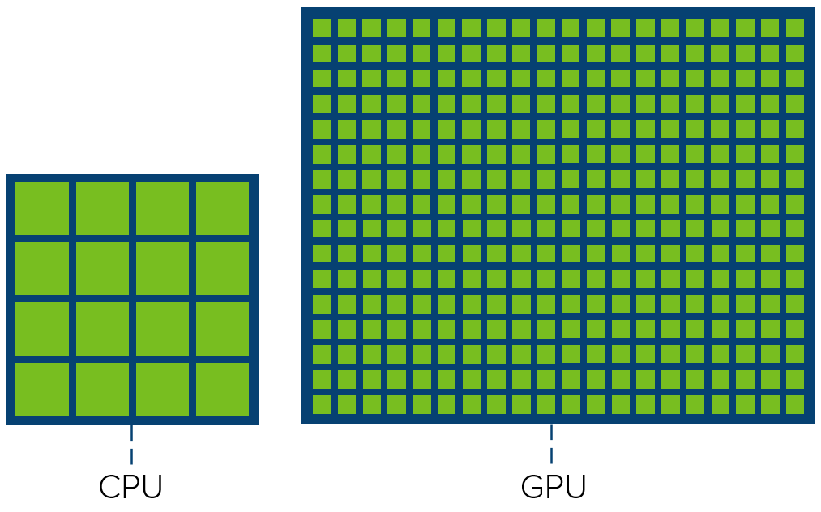
Enter the GPU
3D games like Quake created a market for affordable rendering hardware
The Graphical Processing Unit as we know it was born
GPU design is fundamentally different from CPU
CPU: small number of large cores
GPU: large number of smaller cores
CPU: general-purpose
GPU: specialised for rendering
Advantages
Many pixels can be rendered in parallel
Frees up CPU for other tasks

Slide 5








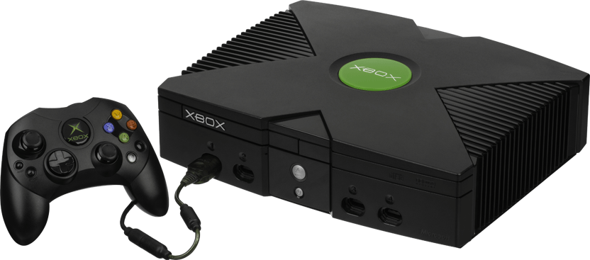

Evolution of API standards
Many different manufacturers of 3D cards
APIs were manufacturer-specific and proprietary
Time consuming, and locked developers in
SGI open sourced IRIS GL API as OpenGL
Backed by John Carmack, quickly rose to dominance
Microsoft followed with DirectX, caught up eventually

Slide 6

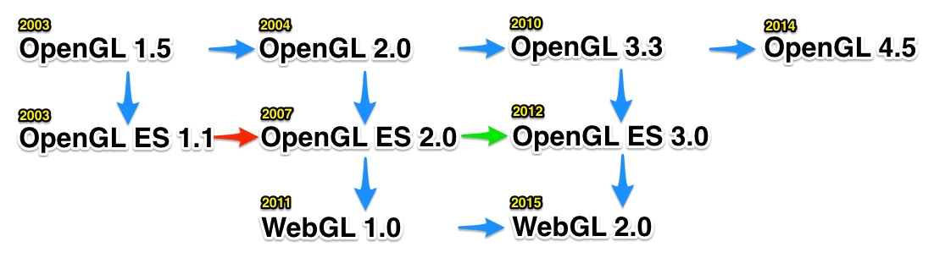
Present Day
Many subsets of OpenGL
OpenGL ES for embedded systems
“Most widely deployed graphics API in history”
WebGL derived from OpenGL ES
WebGL 2.0 released in 2015

Slide 7
The WebGL API

Slide 8
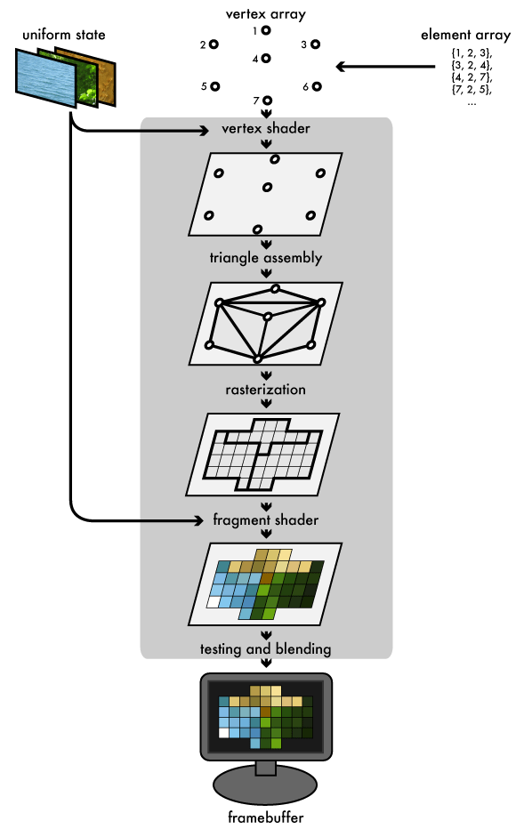
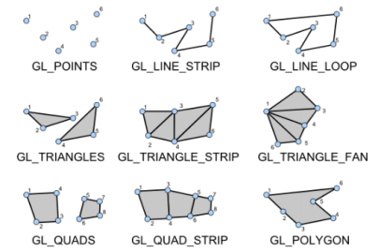
Overview
API access to GPU from Javascript
Agnostic of hardware
Only renders primitives – points, triangles etc.
Programmable pipeline (shaders)
Shader program runs on GPU
API focused on setting up shaders + feeding them with data

Slide 9
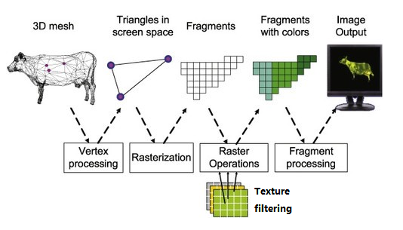
Introducing Shaders

Slide 10
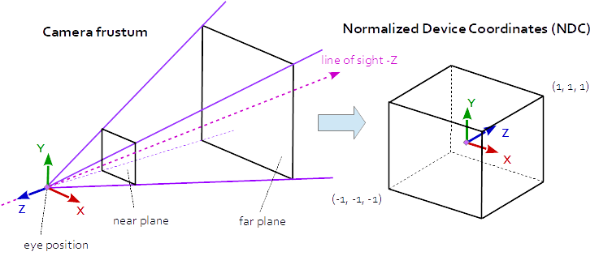
WebGL Coordinate System

Slide 11

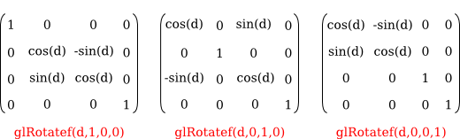

Spaces and Transforms

Slide 12
Demo

Slide 13
Overview and Setup
Demo program renders a textured cube
Cube can be moved and rotated
index.html with canvas, basic styling, and script includes
CDN link to gl-matrix library
http-server to serve page locally
input.js purely for user input
main.js contains the WebGL code

Slide 14
Demo

Slide 15
Demo

Slide 16
Demo

Slide 17
Demo

Slide 18
Demo

Slide 19
Demo

Slide 20
Demo

Slide 21
Demo

Slide 22
Demo

Slide 23
More WebGL Features

Slide 24
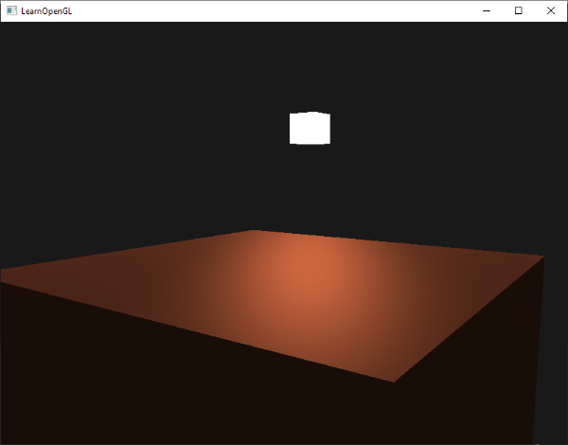
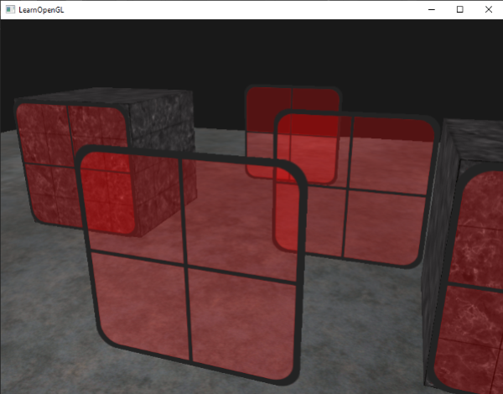
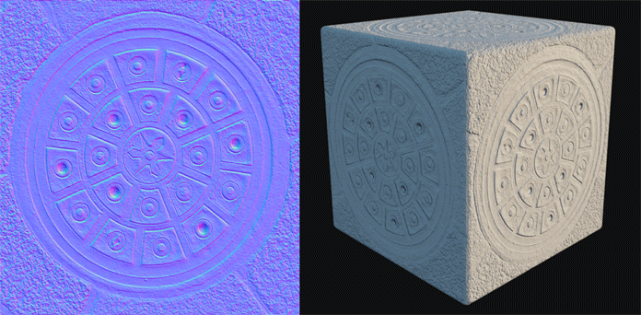


More WebGL features
Lighting
Transparency and blending
Cubemaps and environment maps
Normal maps, parallax maps, refraction etc. (shaders)
WebGL 2.0
3D textures
Async queries (query data from GPU back to CPU)
Non power-of-two texture dimensions
More matrix functions
Instanced rendering
And many more…

Slide 25
Further reading
https://webgl2fundamentals.org
https://developer.mozilla.org/en-US/docs/Web/API/WebGL_API/Tutorial
https://jsantell.com/model-view-projection/
https://learnopengl.com/Getting-started/Hello-Triangle

Slide 26
Questions

